Slide 1
3.1 Selection Structures
ITP3914 – Programming
Part 3 – Basic Program Structures

Slide 2
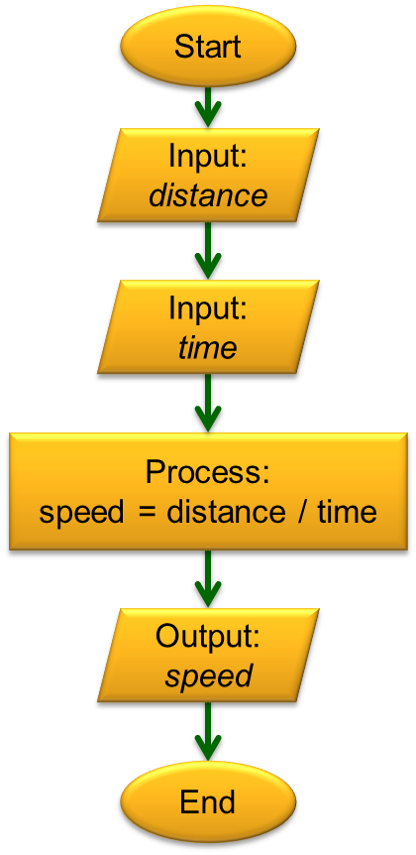
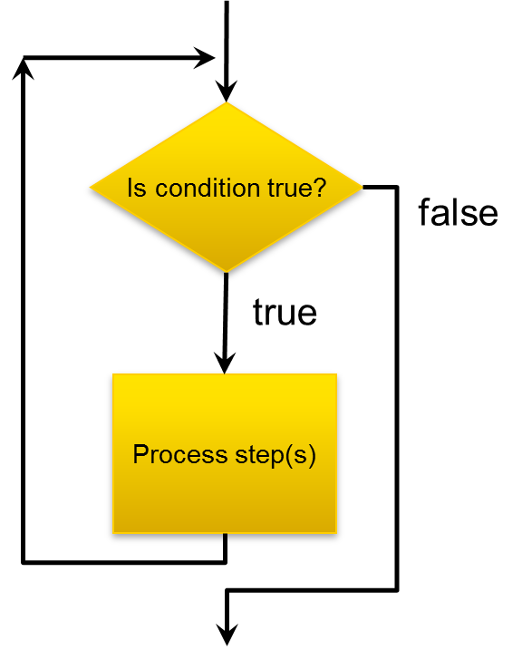
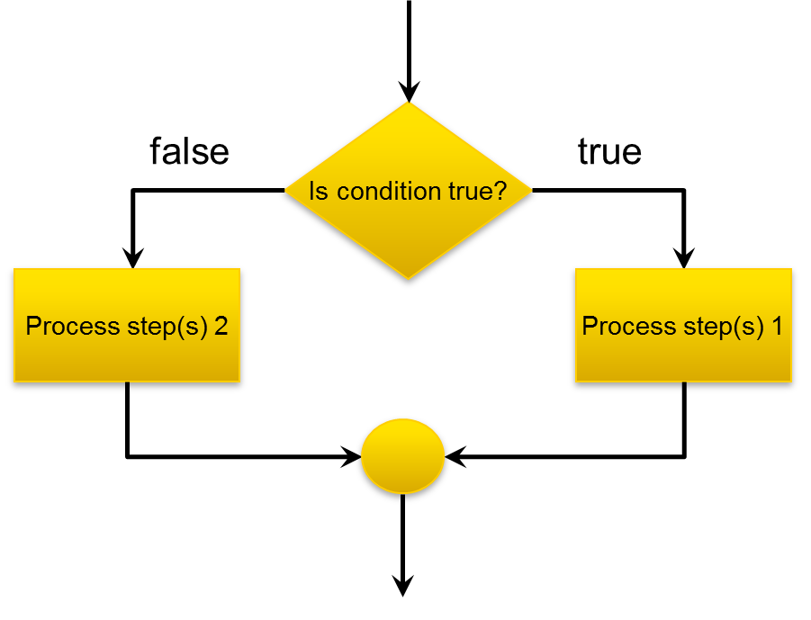
The Structure Theorem
The Structure Theorem states that it is possible to write ANY computer program by using only the three basic control structures:

Slide 3

Part 1 – boolean condition checking

Slide 4
Relational Operators
Binary operators for comparing two values
Returns either true or false
int j=3, k=4, m=4, n=5;
Operator Example Result
Operator Example Result
== k == m true
j == k false
<= k <= m true
n <= m false
!= k != m false
j != k true
>= k >= m true
m >= n false
> n > m true
m > k false
< n < m false
j < k true

Slide 5
Logical Operator – AND
Allows more complex checking by combining two boolean expressions
&& (logical AND) returns true only if both boolean expressions are true.
int j=3, k=4, m=4, n=5;
exp1 exp2 exp1 && exp2
exp1 && exp2 Result
true true true
(j==3)&&(n>m) true
true false false
(j==3)&&(k==5) false
false true false
(j>k)&&(n>m) false
false false false
(j>k)&&(j!=3) false

Slide 6
Logical Operator – OR
Allows more complex checking by combining two boolean expressions
|| (logical OR) returns false only if both boolean expressions are false.
int j=3, k=4, m=4, n=5;
exp1 exp2 exp1 || exp2
exp1 || exp2 Result
true true true
(j==3)||(n>m) true
true false true
(j==3)||(k==5) true
false true true
(j>k)&&(n>m) true
false false false
(j>k)&&(j!=3) false

Slide 7
Logical Operator – NOT
A unary operator that negates the value of a boolean expression
int j=3, k=4, m=4, n=5;
exp1 !exp1
!exp1 Result
true false
!(j==3) false
false true
!(k==5) true

Slide 8
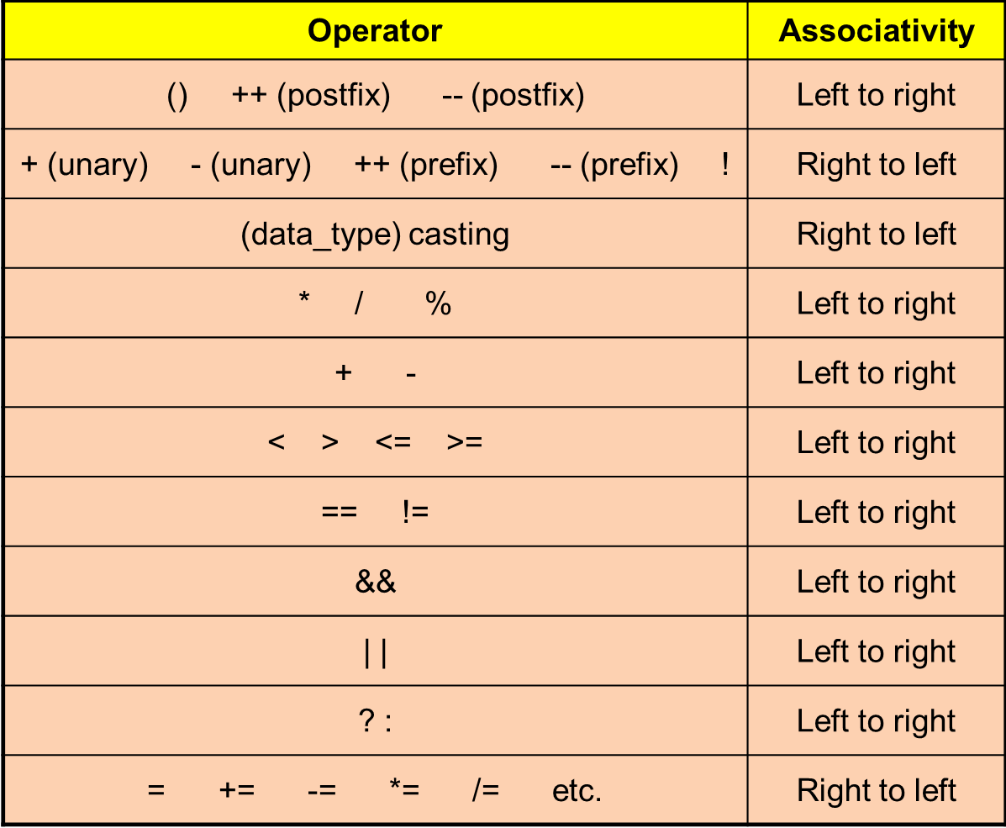
Operator Precedence Again

Slide 9
Part 2 – The if-statement

Slide 10
The Simple if statement
If the boolean condition evaluates to true, the statement is executed.
If the boolean condition evaluates to false, the statement is skipped.
Anyway, the program proceeds to execute the next_statement.
boolean condition
true
false
statement
if (condition)
statement;
next_statement;
next_statement

Slide 11
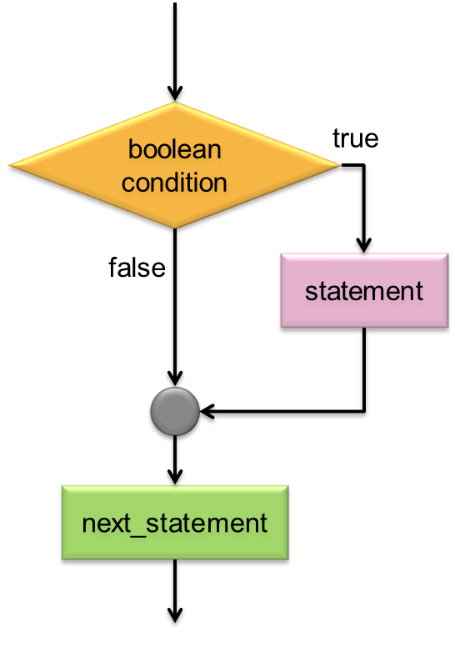
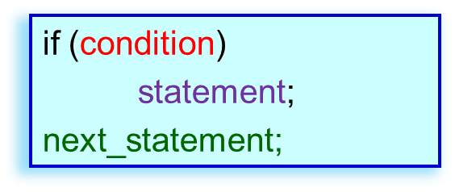
Simple if Example
import java.util.*;
public class SimpleIf {
public static void main(String [ ] args) {
Scanner keyboard = new Scanner(System.in);
int score;
System.out.print("Score? ");
score = keyboard.nextInt();
if (score >= 40)
System.out.println("You got a pass.");
System.out.println("Your score is " + score);
}
}
c:\> java SimpleIf
Score? 80
c:\> java SimpleIf
Score? 80
You got a pass.
c:\> java SimpleIf
Score? 80
You got a pass.
Your score is 80
c:\> java SimpleIf
Score? 30
c:\> java SimpleIf
Score? 30
Your score is 30

Slide 12
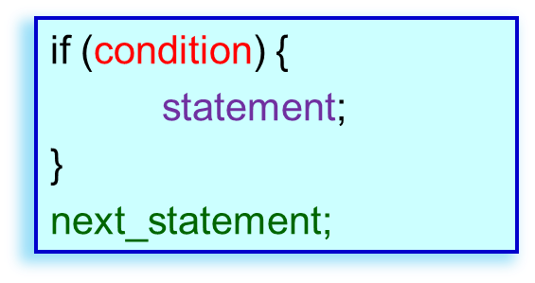
Simple if Again
import java.util.*;
public class SimpleIf2 {
public static void main(String [ ] args) {
Scanner keyboard = new Scanner(System.in);
int score;
System.out.print("Score? ");
score = keyboard.nextInt();
if (score >= 40) {
System.out.println("Congratulations!”);
System.out.println("You got a pass.");
}
System.out.println("Your score is " + score);
}
}
c:\> java SimpleIf2
Score? 80
c:\> java SimpleIf2
Score? 80
Congratulations!
You got a pass.
c:\> java SimpleIf2
Score? 80
Congratulations!
You got a pass.
Your score is 80
c:\> java SimpleIf2
Score? 30
c:\> java SimpleIf2
Score? 30
Your score is 30
Use a pair of { } to enclose the true-part if there are multiple statements.

Slide 13
The if-else statement
If the boolean condition evaluates to true, statement_A is executed.
If the boolean condition evaluates to false, statement_B is executed.
Anyway, the program proceeds to execute the next_statement.
boolean condition
false
true
if (condition)
statement_A
else
statement_B
next_statement;
statement_B
statement_A
next_statement

Slide 14
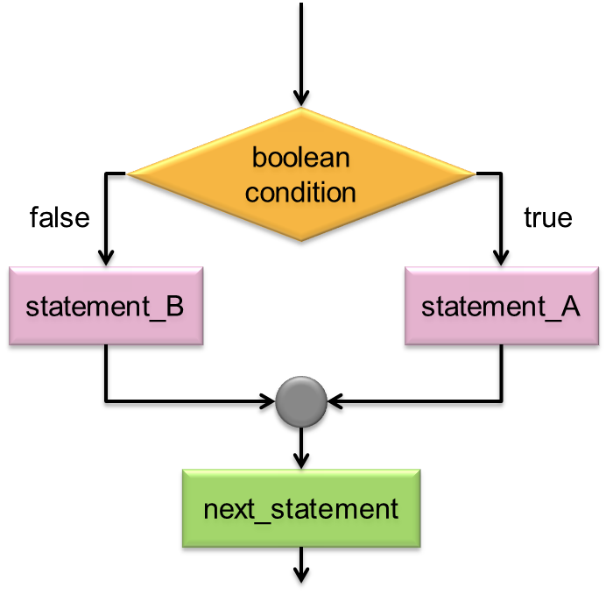
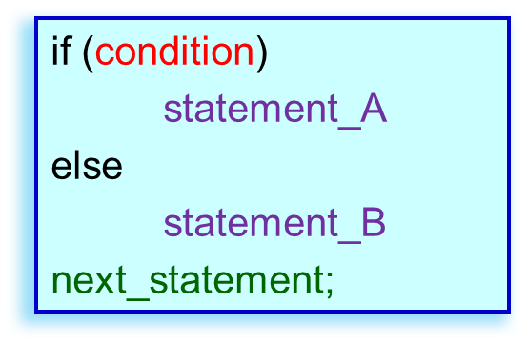
if-else Example
import java.util.*;
public class IfElseEg {
public static void main(String [ ] args) {
Scanner keyboard = new Scanner(System.in);
int score;
char grade;
System.out.print("Score? ");
score = keyboard.nextInt();
if (score >= 40) {
grade = 'P';
System.out.println("Congratulations!");
} else
grade = 'F';
System.out.println("Your score is " + score);
System.out.println("Your grade is " + grade);
}
}
c:\> java IfElseEg
Score? 60
c:\> java IfElseEg
Score? 60
Congratulations!
c:\> java IfElseEg
Score? 60
Congratulations!
Your score is 60
Your grade is P
c:\> java IfElseEg
Score? 30
c:\> java IfElseEg
Score? 30
Your score is 30
Your grade is F

Slide 15
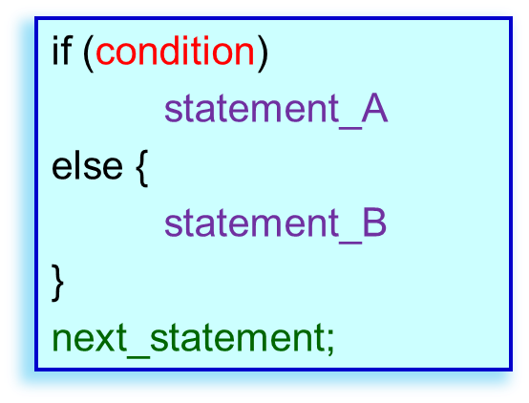
if-else Again
import java.util.*;
public class IfElseEg2 {
public static void main(String [ ] args) {
Scanner keyboard = new Scanner(System.in);
int score;
char grade;
System.out.print("Score? ");
score = keyboard.nextInt();
if (score >= 40) {
grade = 'P';
System.out.println("Congratulations!");
} else {
grade = 'F';
System.out.println("Work hard!");
}
System.out.println("Your score is " + score);
System.out.println("Your grade is " + grade);
}
}
c:\> java IfElseEg2
Score? 60
Congratulations!
Your score is 60
Your grade is P
c:\> java IfElseEg
Score? 30
c:\> java IfElseEg2
Score? 30
Work hard!
Your score is 30
Your grade is F
Use a pair of { } to enclose the else-part if there are multiple statements.

Slide 16

Nested if
If the boolean condition evaluates to true, the statement is executed.
boolean condition
true
The statement itself can be another if-statement.
false
statement
condition_2
true
false
statement_2
if (condition)
statement;
next_statement;
if (condition_2)
statement_2
next_statement

Slide 17
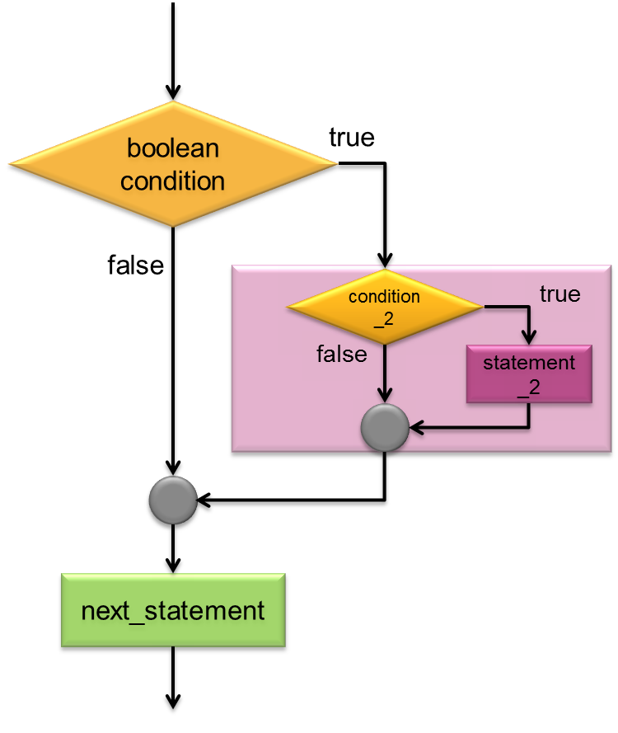
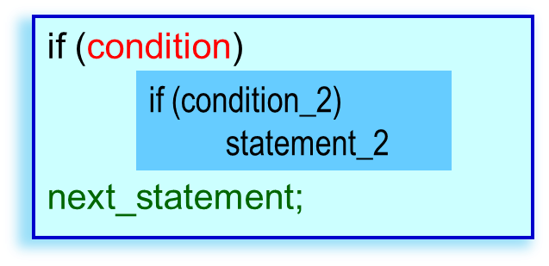
Nested if Example
import java.util.*;
public class NestedIf {
public static void main(String [ ] args) {
Scanner keyboard = new Scanner(System.in);
int score;
System.out.print("Score? ");
score = keyboard.nextInt();
if (score >= 40)
if (score >= 75)
System.out.println("Congratulations! ");
System.out.println("Your score is " + score);
}
}
c:\> java NestedIf
Score? 30
Your score is 30
c:\> java NestedIf
Score? 50
Your score is 50
c:\> java NestedIf
Score? 75
Congratulations!
Your score is 75

Slide 18
if (condition)
if (condition_2)
statement_2A;
else
statement_2B;
next_statement;
boolean condition
true
false
if (score >=40)
if (score >= 75)
System.out.println("Congratulations!");
else
System.out.println("You got a pass.");
System.out.println("Your score is " + score);
false
condition_2
true
statement_2B
statement_2A
next_statement

Slide 19
if (condition)
if (condition_2)
statement_2A;
else
statement_2B;
else
statement_C
next_statement;
false
boolean condition
true
false
condition_2
true
statement_C
statement_2B
statement_2A
if (score >=40)
if (score >= 75)
System.out.println("Congratulations!");
else
System.out.println("You got a pass.");
else
System.out.println("You failed! ");
System.out.println("Your score is " + score);
next_statement

Slide 20
if (condition)
if (condition_2)
statement_2;
else
statement_C
next_statement;
false
boolean condition
true
condition_2
true
An else-part attaches to the nearest if that has not yet been paired.
So the code above is wrong!
statement_C
false
statement_2
if (condition) {
if (condition_2)
statement_2;
} else
statement_C
next_statement;
next_statement

Slide 21
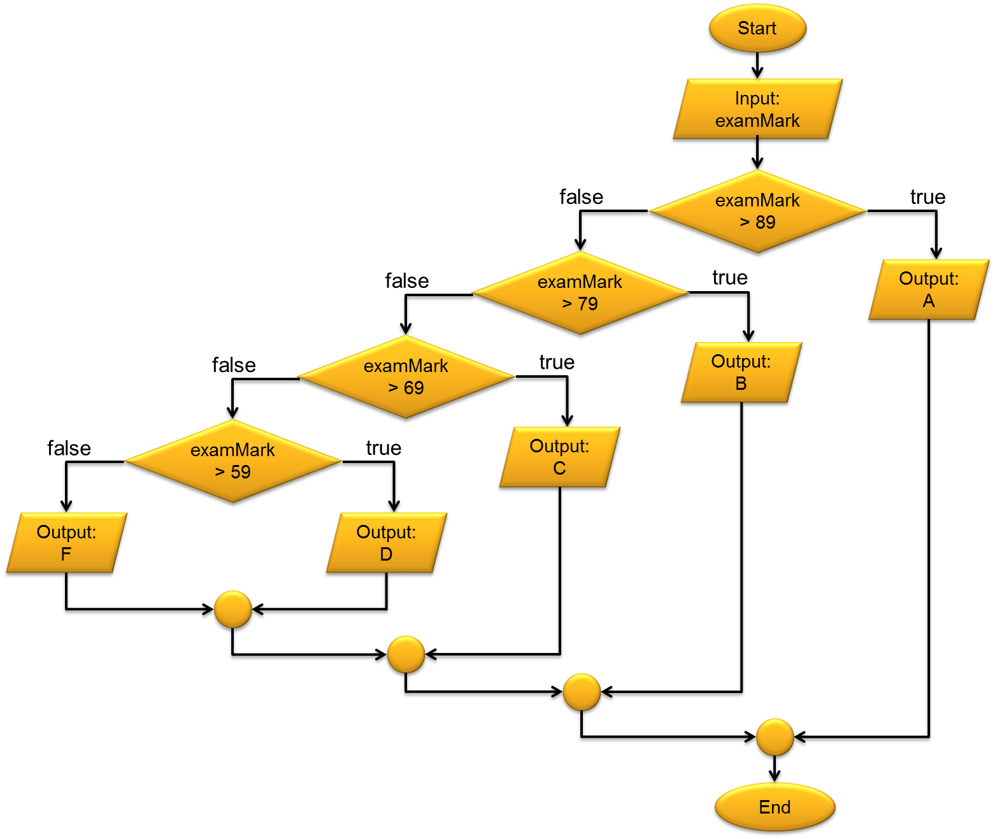
Deeply nested if
if (examMark > 89)
System.out.println("A");
else
if (examMark > 79)
System.out.println("B");
else
if (examMark > 69)
System.out.println("C");
else
if (examMark > 59)
System.out.println("D");
else
System.out.println("F");
if (examMark > 89)
System.out.println("A");
else if (examMark > 79)
System.out.println("B");
else if (examMark > 69)
System.out.println("C");
else if (examMark > 59)
System.out.println("D");
else
System.out.println("F");

Slide 22
Conditional Operator ?:
The conditional operator is similar to an if-else statement, except that it is an expression that returns a value.
if (num1 > num2)
larger = num1;
else
larger = num2;
larger = (num1 > num2) ? num1 : num2 ;
expression value when condition is true.
expression value when condition is false.

Slide 23
Further ?: example
boolean isEven;
…
isEven = (num%2 == 0) ? true : false ;
return true if num is even
int countA;
…
countA += (ch == 'A') ? 1 : 0 ;
increment countA if ch is 'A'
int x, y;
…
y = (x < 0) ? -x : x ;
store the absolute value of x into y

Slide 24
Part 3 – The switch-statement

Slide 25
The switch statement
switch (expression) {
case value1:
statement(s);
break;
case value2:
statement(s);
break;
…
default:
statement(s);
}
The switch statement tries to match which case has the same value as the switch expression.
The switch expression must have a data type of byte, short, int or char (but not long or double).
When the first match is found, the statement(s) starting just under the match are executed until a break statement.
If no match is found, the default case will be executed.
If there is no match case and no default case, nothing is executed.
What are you talking about?????

Slide 26
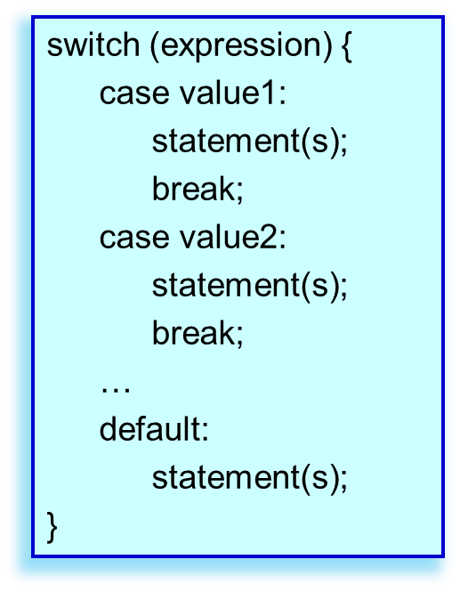
import java.util.*;
public class SwitchEg {
public static void main(String [ ] args) {
Scanner keyboard = new Scanner(System.in);
int value;
System.out.print("value? ");
value = keyboard.nextInt();
switch (value) {
case 1:
System.out.println("One");
break;
case 2:
System.out.println("Two");
break;
case 3:
System.out.println("Three");
break;
default:
System.out.println("Invalid value");
}
System.out.println("after switch");
}
}
c:\> java SwitchEg
value? 1
c:\> java SwitchEg
value? 1
One
c:\> java SwitchEg
value? 1
One
after switch
c:\> java SwitchEg
value? 3
c:\> java SwitchEg
value? 3
Three
c:\> java SwitchEg
value? 3
Three
after switch
c:\> java SwitchEg
value? 5
c:\> java SwitchEg
value? 5
Invalid value
c:\> java SwitchEg
value? 5
Invalid value
after switch
26

Slide 27
import java.util.*;
public class SwitchEg2 {
public static void main(String [ ] args) {
Scanner keyboard = new Scanner(System.in);
int value;
System.out.print("value? ");
value = keyboard.nextInt();
switch (value) {
case 1:
System.out.println("One");
case 2:
System.out.println("Two");
case 3:
System.out.println("Three");
break;
default:
System.out.println("Invalid value");
}
System.out.println("after switch");
}
}
c:\> java SwitchEg2
value? 1
c:\> java SwitchEg2
value? 1
One
c:\> java SwitchEg2
value? 1
One
Two
c:\> java SwitchEg2
value? 1
One
Two
Three
c:\> java SwitchEg2
value? 1
One
Two
Three
after switch
c:\> java SwitchEg2
value? 3
c:\> java SwitchEg2
value? 3
Three
c:\> java SwitchEg2
value? 3
Three
after switch

Slide 28
import java.util.*;
public class SwitchQuestion {
public static void main(String [ ] args) {
Scanner keyboard = new Scanner(System.in);
int value;
System.out.print("value? ");
value = keyboard.nextInt();
switch (value) {
case 1:
sayHello();
break;
case 2:
sayHello(); sayHello();
break;
case 3:
sayHello(); sayHello(); sayHello();
break;
case 4:
sayHello(); sayHello(); sayHello(); sayHello();
break;
default:
System.out.println("Invalid value");
}
System.out.println("Bye!");
}
public static void sayHello() {
System.out.println("Hello");
}
}
Can you rewrite the program with exactly the same function but using only 4 sayHello()?
This is a method.
We will discuss it very soon.

Slide 29
END

Slide 30
Operator | Associativity
() ++ (postfix) -- (postfix) | Left to right
+ (unary) - (unary) ++ (prefix) -- (prefix) ! | Right to left
(data_type) casting | Right to left
* / % | Left to right
+ - | Left to right
< > <= >= | Left to right
== != | Left to right
&& | Left to right
| | | Left to right
? : | Left to right
= += -= *= /= etc. | Right to left

